Slide 1
6. 目标检测 （人脸 & 行人）
罗志明
zhiming.luo@xmu.edu.cn

Slide 2
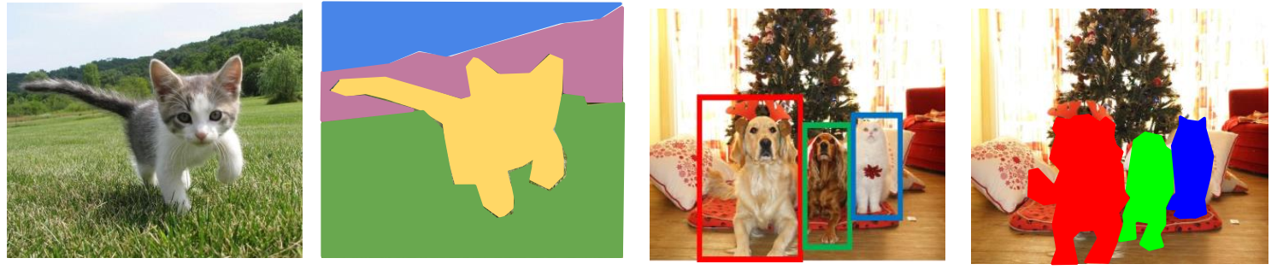
经典的视觉识别任务
图像分类
语义分割
目标检测
实例分割

Slide 3
提纲
目标检测简介
人脸检测与识别
行人检测

Slide 4
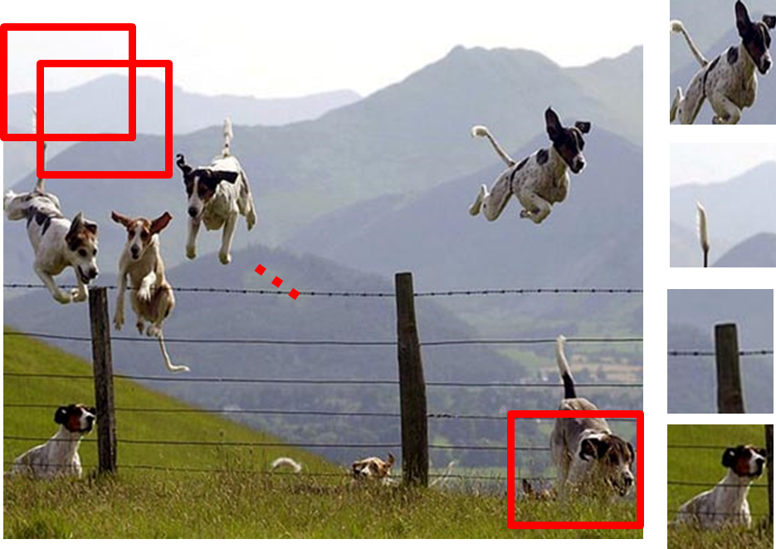
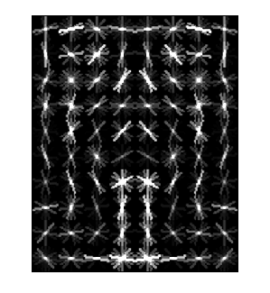
目标检测
目的：定位目标物体的具体位置
方法：构建模型快速区分目标框(Object)与非目标框(Non-object) 。
Dog Model
Object or Non-Object?
Slide from: D. Hoiem

Slide 5
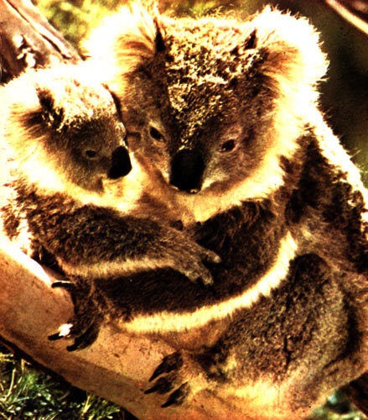
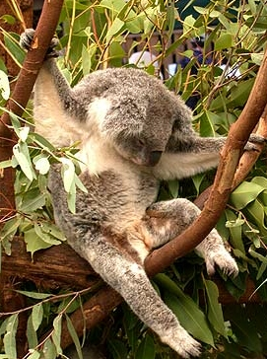
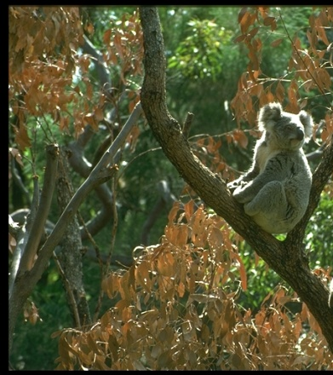
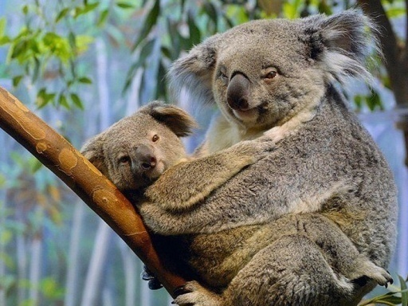
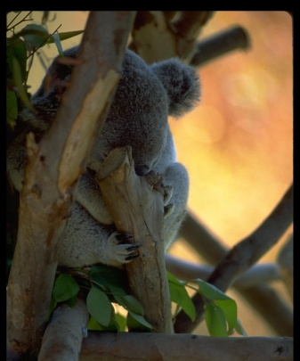
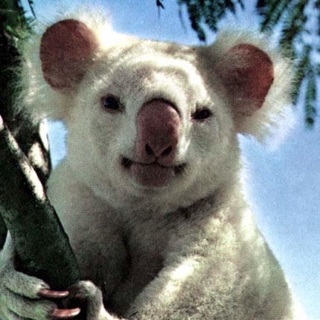
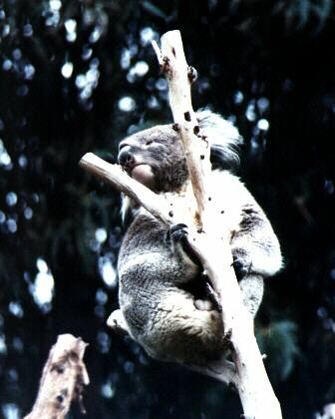
目标物体类建模的难点
光照
姿态
复杂背景
遮挡
类内外观差异
视角
Slide from K. Grauman, B. Leibe

Slide 6
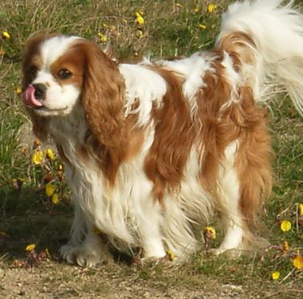
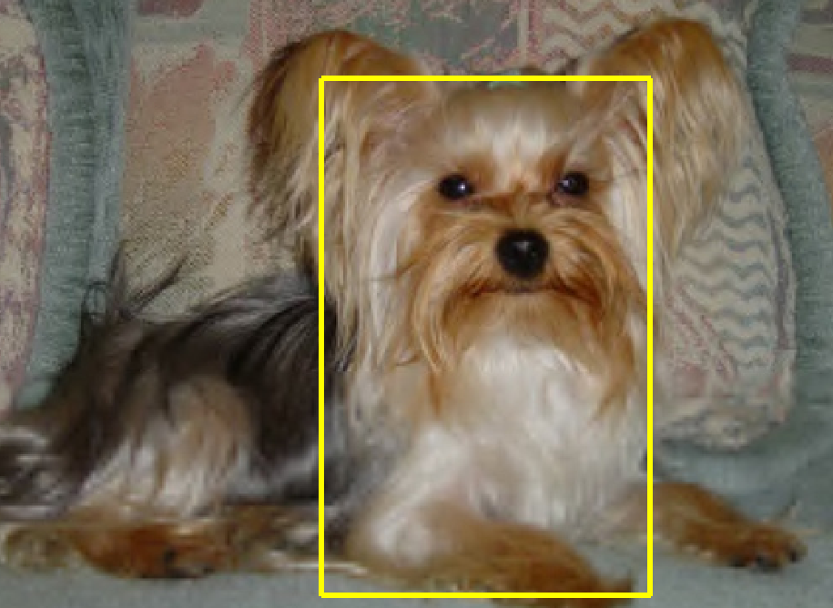
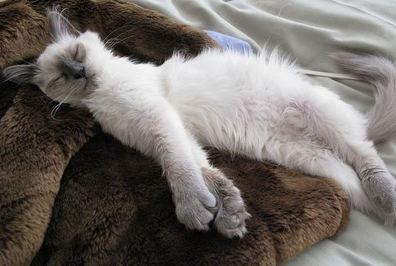
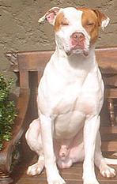
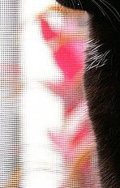

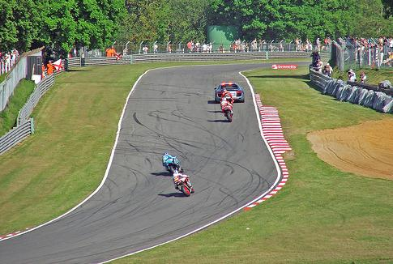

非目标物体建模的难点
定位误差
相似物体类
正确检测
错误检测的背景
非相似物体
Slide from: D. Hoiem

Slide 7
构建目标检测器的难点
载入目标检测器
特征与分类器
设计合适的特征来表示目标？
选择合适的分类器进行建模？
如何快速查找可能目标？
需要对大量的候选框进行判断
生成候选框
对候选框打分
最终的检测结果
目标检测的通用流程
Slide from: D. Hoiem

Slide 8
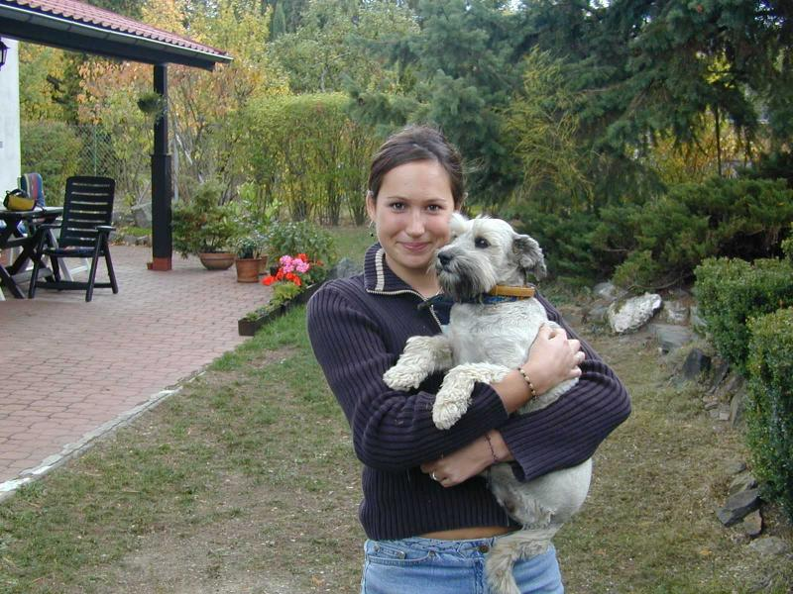
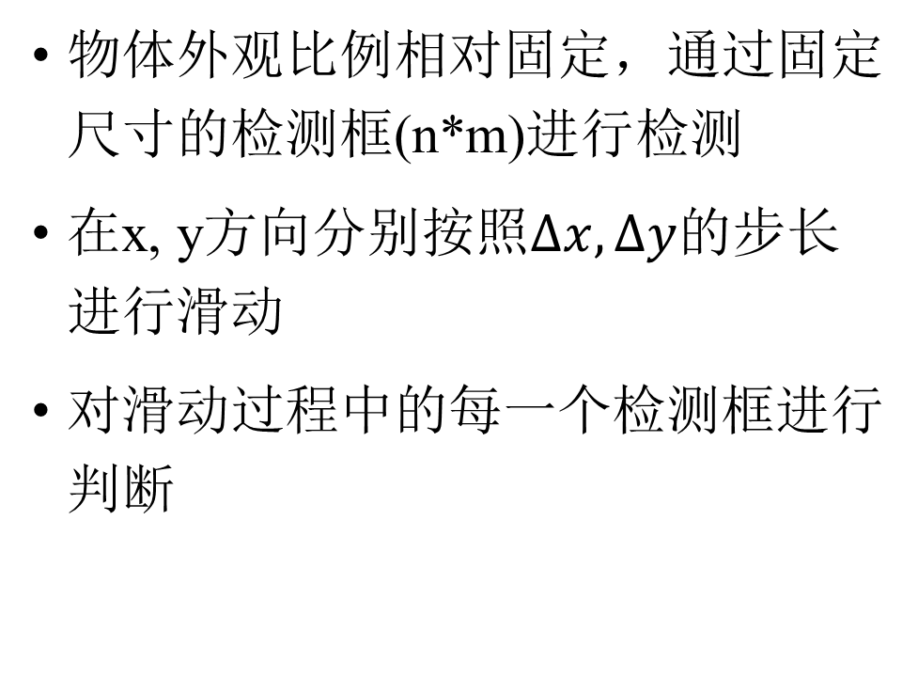
滑动窗口法
物体外观比例相对固定，通过固定尺寸的检测框(n*m)进行检测
在x, y方向分别按照$∆x, ∆y$的步长进行滑动
对滑动过程中的每一个检测框进行判断

Slide 9
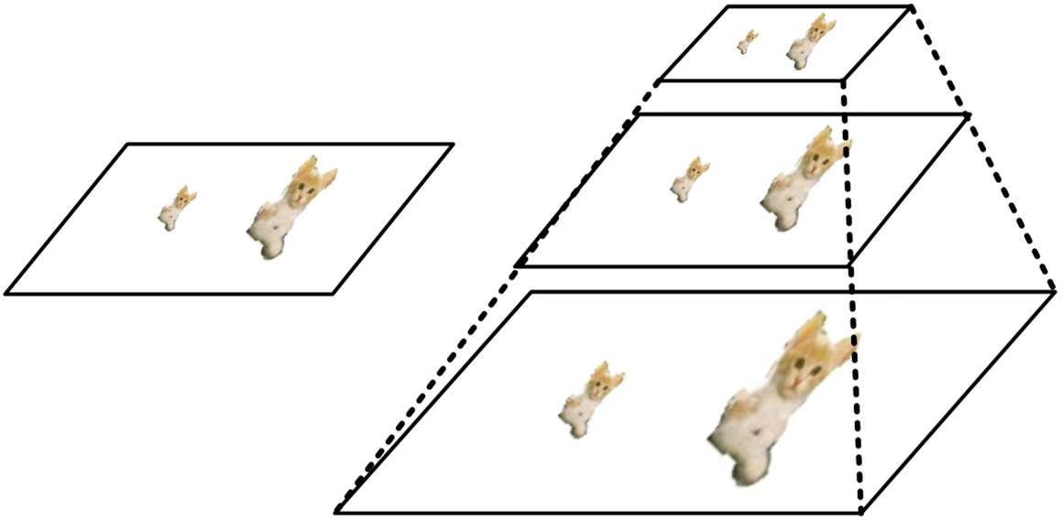
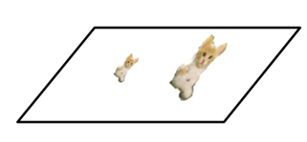
尺度
两种常用的处理不同目标尺度大小的方法
Image Pyramid
Filter Pyramid

Slide 10
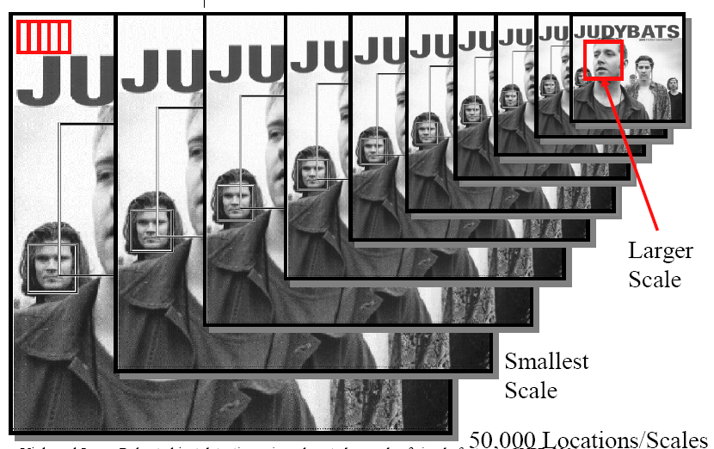
滑动窗口 + 尺度

Slide 11
提纲
目标检测简介
人脸检测与识别
Viola/Jones人脸检测器
LBP人脸识别
行人检测

Slide 12
人脸检测
Behold a state-of-the-art face detector!
(Courtesy Boris Babenko)
Slide from S. Lazebnik

Slide 13

人脸检测与识别
Detection
Recognition
“Sally”
Step #1: 输入图像、使用检测器进行“人脸检测”、
提取人脸区域
Step #2: 对提取的人脸区域进行“人脸识别”

Slide 14
人脸检测难点
滑动窗口法：待检测的框数量多、不同的尺度
人脸数量少：通常0~10张人脸
计算效率：对非人脸框的计算消耗要尽可能少
误检率要尽可能的低

Slide 15
Viola/Jones人脸检测器
实时人脸检测的开创性工作
训练时间长、检测的效率高
主要思想：
通过积分图进行快速地特征计算
Boosting算法进行特征选择
Cascade级联快速地排除非人脸区域
P. Viola and M. Jones. Rapid object detection using a boosted cascade of simple features. CVPR 2001.
P. Viola and M. Jones. Robust real-time face detection. IJCV 57(2), 2004.

Slide 16
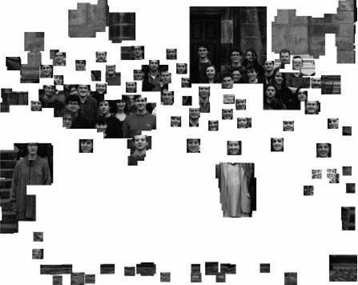
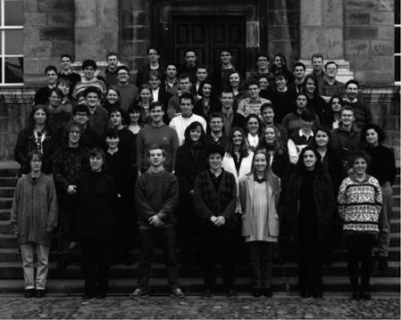
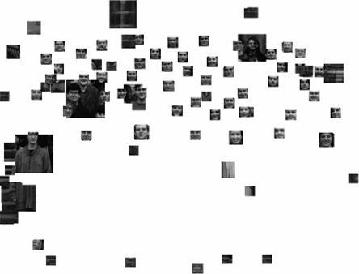
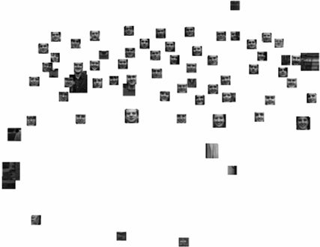
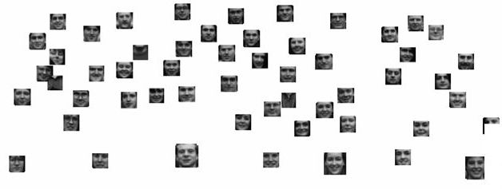
Viola/Jones人脸检测器
Pictures from Romdhani et al. ICCV01

Slide 17
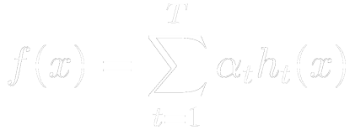


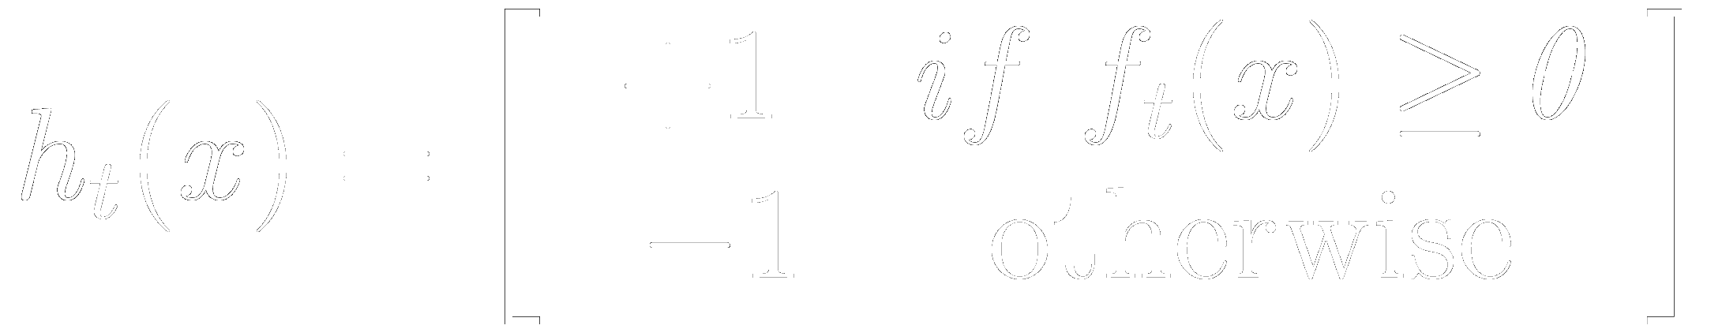
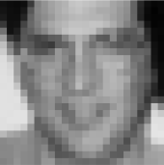

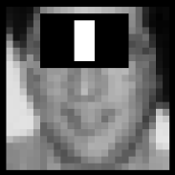
AdaBoost分类器
Strong classifier
Weak classifier
Weak classifiers: Haar-basis like functions

Slide 18
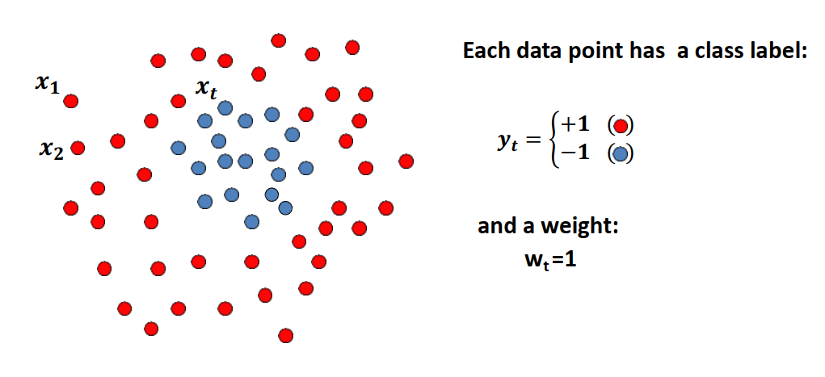
Boosting - procedure
It’s a sequential procedure

Slide 19
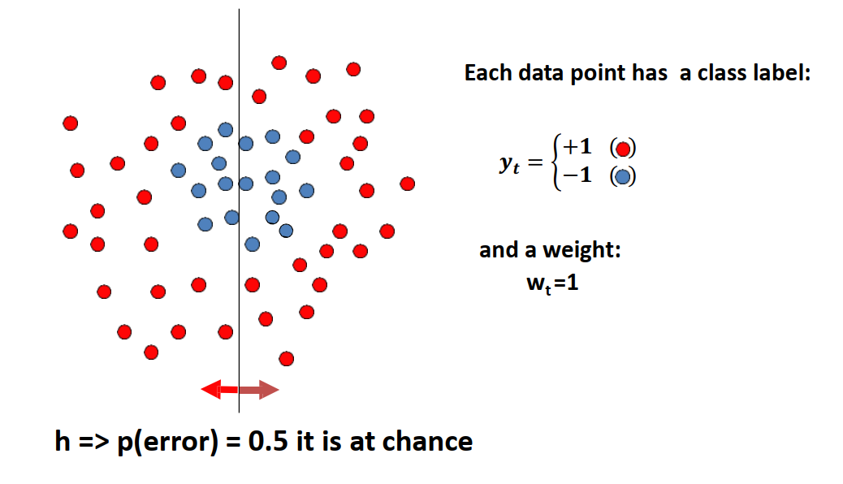
Boosting – Toy example
Weak learners from the family of lines

Slide 20
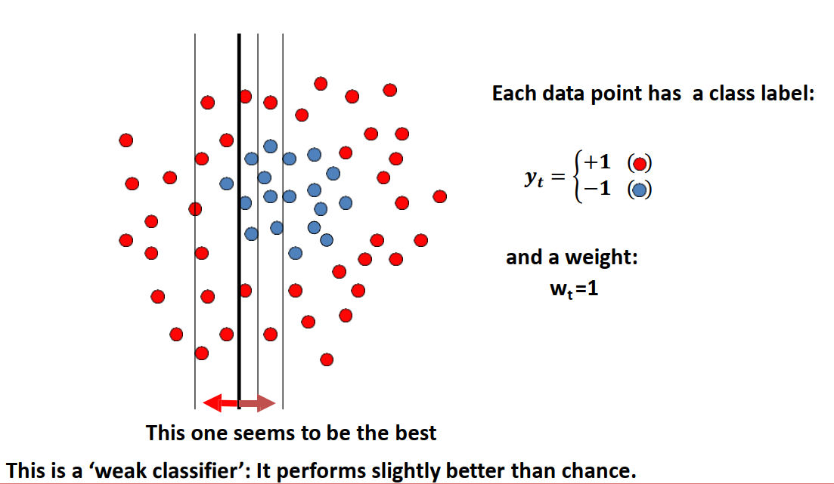
Boosting – Toy example

Slide 21
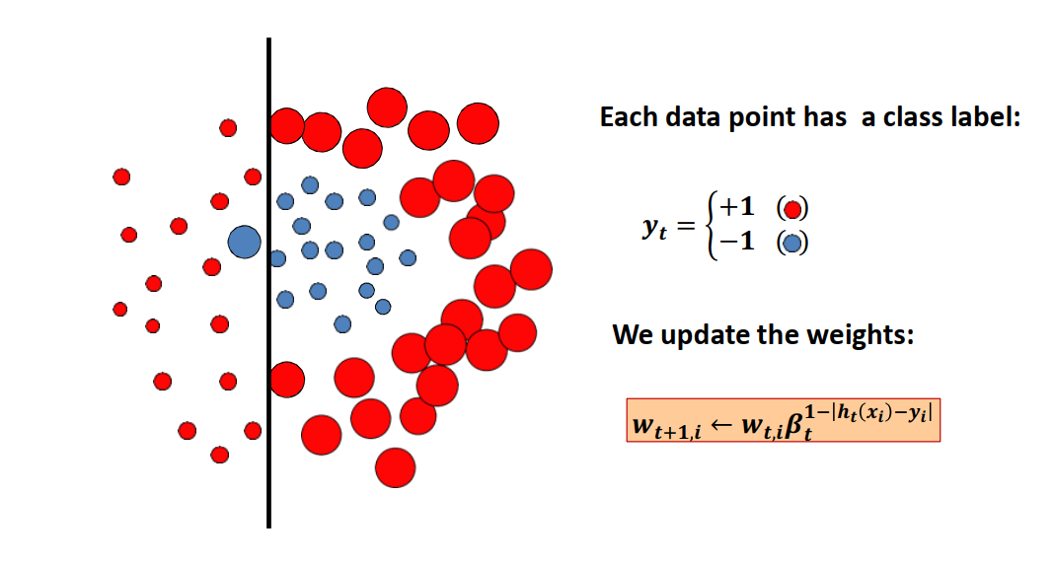
Boosting – Toy example

Slide 22
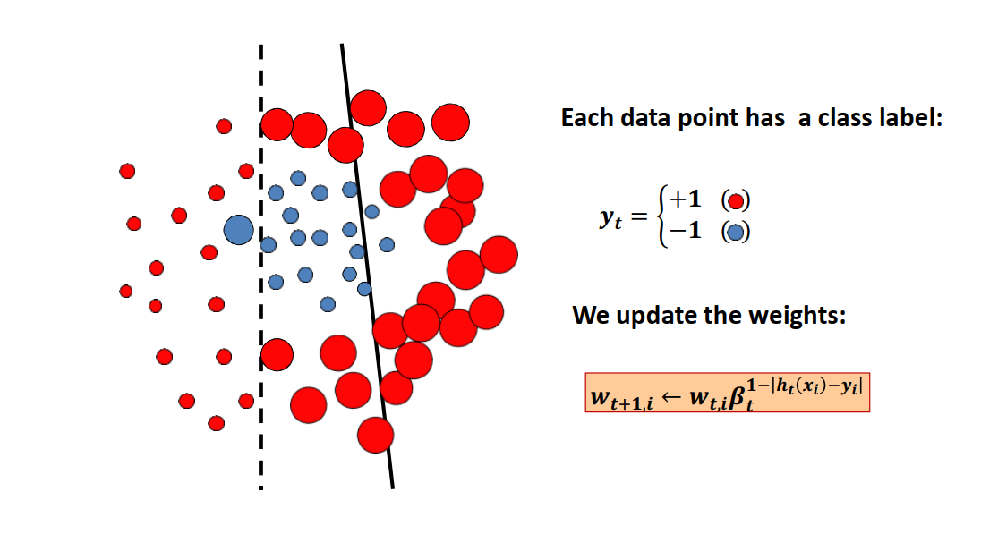
Boosting – Toy example

Slide 23
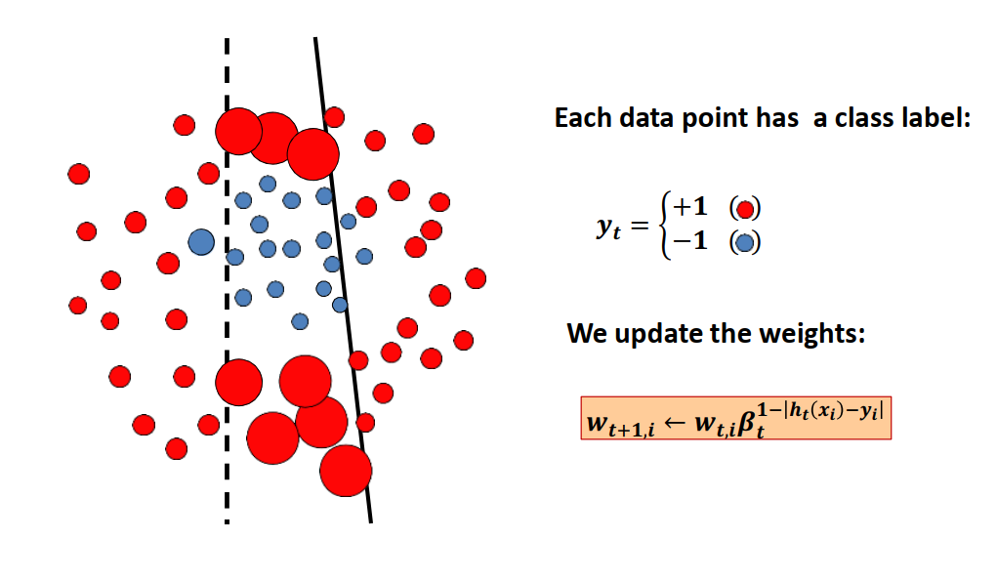
Boosting – Toy example

Slide 24
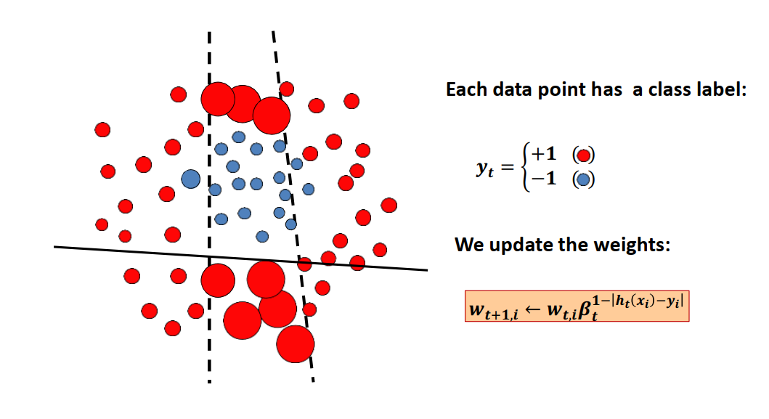
Boosting – Toy example

Slide 25
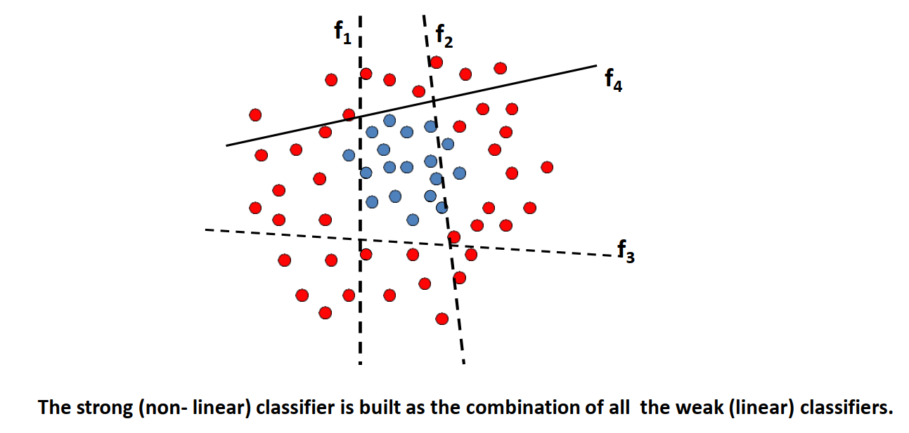
Boosting – Toy example

Slide 26
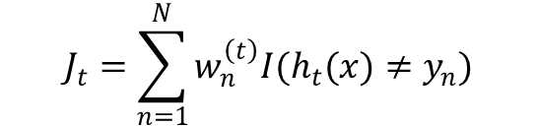

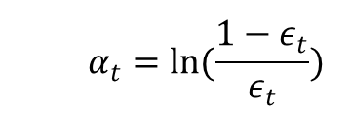
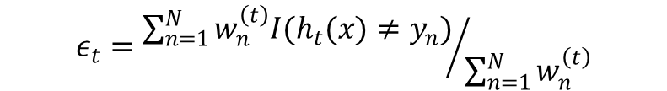
AdaBoost
Strong classifier
Weak classifier
Initialize the data weights $\left\{w_{n}\right\}$ by $w_{n}^{(1)}=1/N$ for $n=1,…, N$.
For $t=1,…, T$
Learn a classifier $h_{t}(x)$ that minimizes the weighted error
Evaluate
and set
$$J_{t}=\sum_{n=1}^{N}{w_{n}^{\left(t\right)}I(h_{t}(x)≠y_{n})}$$
$$ε_{t}={\sum_{n=1}^{N}{w_{n}^{\left(t\right)}I(h_{t}(x)≠y_{n})}}/{\sum_{n=1}^{N}{w_{n}^{\left(t\right)}}}$$
$$α_{t}=ln(\frac{1−ε_{t}}{ε_{t}})$$

Slide 27

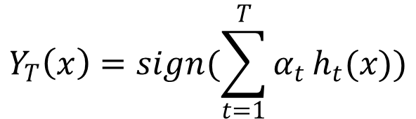
AdaBoost
Strong classifier
Weak classifier
Update the data weighting coefficients
Make predictions using the final model by
$$w_{n}^{\left(t+1\right)}=w_{n}^{\left(t\right)}exp(α_{t}I(h_{t}(x)≠y_{n}))$$
$$Y_{T}\left(x\right)=sign(\sum_{t=1}^{T}{α_{t}}h_{t}(x))$$

Slide 28

AdaBoost人脸检测
Defines a classifier using an additive model:
$$h\left(x\right)=α_{1}h_{1}\left(x\right)+α_{2}h_{2}\left(x\right)+α_{3}h_{3}\left(x\right)+…$$
We need to define a family of weak classifiers
Strong
classifier
Weak
classifier
Weak classifiers: Haar-basis like functions

Slide 29
Image Features / Weak classifier
“Haar-like feature”
4 kinds of Rectangle filters
Differences of sums of intensity
Thousands, computed at various positions and scales within detection window
-1
+1
Two-rectangle features
Three-rectangle features
Etc.

Slide 30
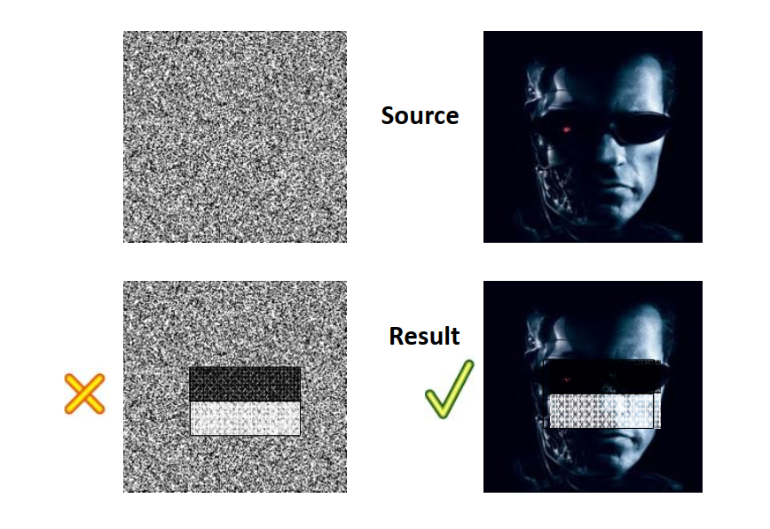
Image Features / Weak classifier

Slide 31
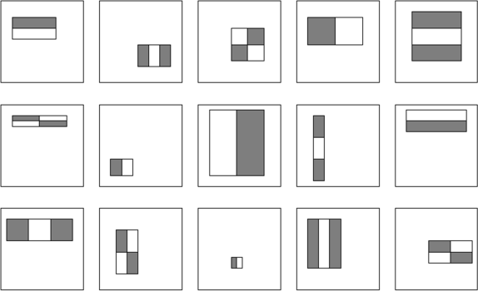
Image Features / Weak classifier
For a 24*24 detection region, the number of possible rectangle features is ~160,000 !
P. Viola and M. Jones. Rapid object detection using a boosted cascade of simple features. CVPR 2001.

Slide 32
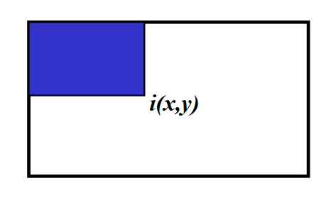
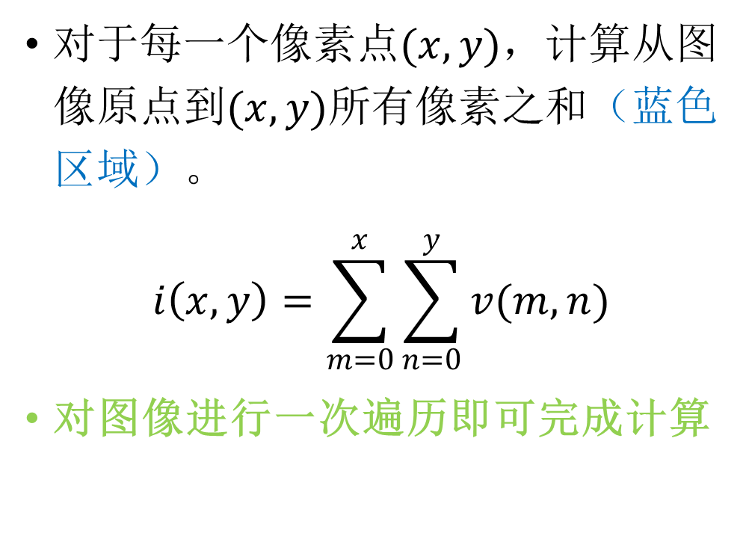
积分图 (Integral Image)
对于每一个像素点$(x,y)$，计算从图像原点到$(x,y)$所有像素之和（蓝色区域）。
$$i\left(x,y\right)=\sum_{m=0}^{x}{\sum_{n=0}^{y}{v(m,n)}}$$
对图像进行一次遍历即可完成计算

Slide 33
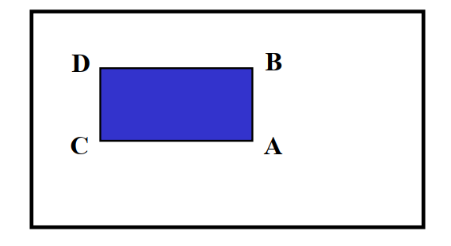
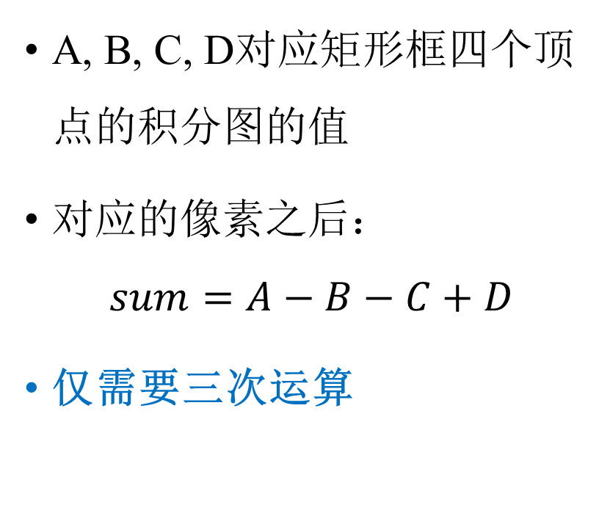
任意矩形框内的像素之后
A, B, C, D对应矩形框四个顶点的积分图的值
对应的像素之后：
$$sum=A−B−C+D$$
仅需要三次运算

Slide 34

Viola & Jones algorithm
Evaluate each rectangle filter on each example

Slide 35


Viola & Jones algorithm
Select best filter/threshold combination
Reweight examples

Slide 36
Viola & Jones algorithm
一个24*24的窗口就有160000个特征
文章中说200个特征就能够提供95%的准确度
最后使用6000个特征
如何进一步降低计算复杂度？

Slide 37

Cascade for Fast Detection
文章作者将 6000 多个特征分为 38 个阶段，前五个阶段的特征数分别为 1、10、25、25 和 50。
Fast classifiers early in cascade which reject many negative examples but detect almost all positive examples.
Slow classifiers later, but most examples don’t get there.
采用Haar Cascades进行人脸检测

Slide 38


后处理
非极大值抑制

Slide 39



非极大值抑制

Slide 40

YuNet (CNN) vs. Haar
YuNet于2018年12月发布，2019年3月开源。它是一个强大的、轻量级的人脸检测模型，可以装载在大部分设备上运行。YuNet的人脸检测速度可达到1000fps，并且可以检测很多较难检测的对象，如被遮挡的人脸、侧脸等。
OpenCV人脸检测：级联分类器与YuNet效果对比

Slide 41


YuNet (CNN) vs. Haar

Slide 42


YuNet (CNN) vs. Haar

Slide 43
提纲
机器学习基础
目标检测简介
人脸检测与识别
Viola/Jones人脸检测器
LBP人脸识别
行人检测

Slide 44

人脸识别
人脸识别发展的简要历史

Slide 45

人脸识别

Slide 46

Local Binary Patterns (LBP) for Face Recognition
T. Ahonen et al. Face Recognition with Local Binary Patterns ECCV 2004.

Slide 47


LBP Operator
One of the best performing texture descriptors
A label is assigned to every pixel
Use center pixel value to threshold the 3*3 neighborhood
Result in binary number
Histogram of the labels is used as texture descriptor
The Basic LBP operator

Slide 48

LBP Operator (2)
LBP is extended to use different sizes of neighborhoods.
Local neighborhoods is defined as a set of sampling points.
points evenly spaced on a circle centered at the labeled pixel.
(P, R), P = number of sampling points , R = radius
Bilinear interpolation is used if sampling point is not in the center of the pixel.
The circular (8,1), (16,2) and (8,2) neighborhoods. The pixel values are bilinearly
interpolated whenever the sampling point is not in the center of a pixel.

Slide 49















线性插值（Linear Interpolation）
Interpolate the value $f(p)$of a point $p$ between $p1$and $p2$
$f(p)$ is the weighted sum of $f(p_{1})$ and $f(p_{2})$
$w_{1}$ and $w_{2}$ are inversely proportional to $d_{1}$ and $d_{2}$
$$f(p1)$$
$$f(p)$$
$$f(p2 )$$
$$f\left(p\right)=\frac{d_{2}}{d}×f\left(p_{1}\right)+\frac{d_{1}}{d}×f\left(p_{2}\right)$$
$$p1$$
$$d1$$
𝑝
$$d2$$
𝑝₂
𝒅
$$d$$

Slide 50


双线性插值（Bilinear Interpolation）
A way to interpolate point value on a 2D grid
Using linear interpolation twice (horizontal & vertical)

Slide 51
Uniform LBP
Uniform patterns to further improve LBP.
Uniform patterns has at most 2 bitwise transitions in binary pattern.
Histogram assigns separate bin for every uniform pattern.
Histogram assigns a single bin for all non-uniform pattern.
In FERET dataset, (8,1) neighborhoods : 90.6 percent of patterns are uniform.

Slide 52

Uniform LBP
Uniform patterns examples
00000000 (0 transitions)
01110000 (2 transitions)
11001111 (2 transitions)
Non-uniform patterns examples
11001001 (4 transitions)
01010011 (5 transitions)
59 bins histogram

Slide 53

LBP Histogram

Slide 54

Face description using LBP
Step 1: facial image is divided into local regions (blocks)
Step 2: Extract LBP histogram for each region.
Step 3: Concatenated all histograms into a spatially enhanced histogram.

Slide 55





Compute the Distance
Euclidean Distance
$$D\left(X,Y\right)=\sqrt{\sum_{i}{(x_{i}−y_{i})^{2}}}$$
$$X=[x_{1},…,x_{n}]$$
$$Y=[y_{1},…,y_{n}]$$

Slide 56






Other Distance Metrics
Histogram intersection
Log-likelihood statistic:
Chi-square statistic ($χ^{2}$)
$$D\left(X,Y\right)=\sum_{i}{min⁡(X_{i},Y_{i})}$$
$$D\left(X,Y\right)=−\sum_{i}{X_{i}log⁡(Y_{i})}$$
$$X=[x_{1},…,x_{n}]$$
$$Y=[y_{1},…,y_{n}]$$
$$χ^{2}\left(X,Y\right)=−\sum_{i}{\frac{{(X_{i}−Y_{i})}^{2}}{X_{i}+Y_{i}}}$$

Slide 57


Weighting the important region
Specific facial features (such as eyes) contains more important information
Be weighted based on the importance of information

Slide 58

Perform the Recognition
Gallery and Probe Pictures

Slide 59
提纲
机器学习基础
目标检测简介
人脸检测与识别
行人检测

Slide 60

行人检测 (Pedestrian Detection)

Slide 61





行人检测的难点
姿态
衣着
光照
背景
遮挡
…

Slide 62



行人检测的难点
City
Rural Area
姿态
衣着
光照
背景
遮挡
…

Slide 63

Dalal-Triggs行人检测器 (HOG)
通过滑动窗口法在不同尺度下提取64*128像素的矩形框
计算每一个框的梯度直方图特征(HOG)
通过Linear SVM对每一个候选框进行打分
采用非极大值抑制去除得分低的检测框
Dalal, Navneet, and Bill Triggs. "Histograms of oriented gradients for human detection." In CVPR, pp. 886-893, 2005.

Slide 64

Dalal-Triggs行人检测器 (HOG)

Slide 65

预处理
假设预设的高宽比是2:1 （128*64）

Slide 66



HOG
计算水平方向和垂直方向的梯度
$G_{x}\left(x,y\right)=I\left(x+1,y\right)−I(x−1,y)$
$G_{y}\left(x,y\right)=I\left(x,y+1\right)−I(x,y−1)$
$G\left(x,y\right)=\sqrt{G_{x}^{2}+G_{y}^{2}}$
$α\left(x,y\right)=arctan⁡(\frac{G_{y}}{G_{x}})$
X方向梯度
Y方向梯度
梯度幅值

Slide 67

HOG
计算梯度直方图
将图像分成若干个8*8大小的网格
计算每一个网格的梯度直方图

Slide 68


HOG
计算梯度直方图
将图像分成若干个8*8大小的网格
计算每一个网格的梯度直方图
直方图是有9个bin
Bin的值：每个角度对应的幅值之和

Slide 69

HOG
计算梯度直方图
将图像分成若干个8*8大小的网格
计算每一个网格的梯度直方图
直方图是有9个bin
Bin的值：每个角度对应的幅值之和

Slide 70


HOG
Cell进行归一化
问题：图像梯度对于光照很敏感
解决方法：
2*2网格构成一个Cell
对向量采用L2归一化
$$\tilde{v}=\frac{v}{\left\|v\right\|}$$

Slide 71


HOG
特征维度 （128*64）
Cell数目：$\left(\frac{128}{8}−1\right)∗\left(\frac{64}{8}−1\right)=105$
维度：$105∗36=3780$

Slide 72



Linear SVM
$y=w^{T}x+b$

Slide 73

可视化

Slide 74


多尺度检测
HOG pyramid

Slide 75


例子
https://pyimagesearch.com/2015/11/09/pedestrian-detection-opencv/

Slide 76
课后作业
完成一个人脸识别的程序，可以识别你宿舍的几位同学
人脸检测
人脸特征提取与比对
提交形式: Python代码 + 1~2页的报告
两周内提交

Slide 77
课后作业
参考资料
https://docs.opencv.org/4.5.4/d0/dd4/tutorial_dnn_face.html
https://blog.csdn.net/qq_36563273/article/details/121510440
人脸检测器: cv2.FaceDetectorYN
人脸特征提取：cv2.FaceRecognizerSF

